Slide 1
Advanced Data Visualization
#First_Session
2021-2022

Slide 2

Table OF Content:
Data Visualization
What is Plotly
Bar Charts
Box Plots
Violin Plots
Question Time

Slide 3
Data visualization
It is the graphical representation of information and data. By using visual elements like charts, graphs, and maps, data visualization tools provide an accessible way to see and understand and identify the Patterns, Trends, Correlations, and Outliers of data sets.
In the world of Big Data, data visualization tools and technologies are essential to analyze massive amounts of information and make data-driven decisions.

Slide 4
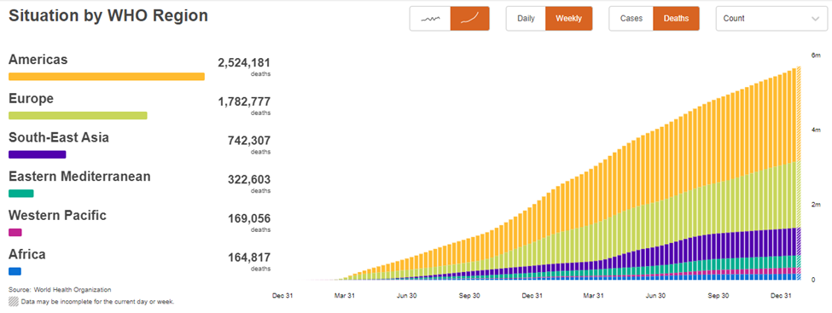
Example:
1- Covid 19 Trend

Slide 5
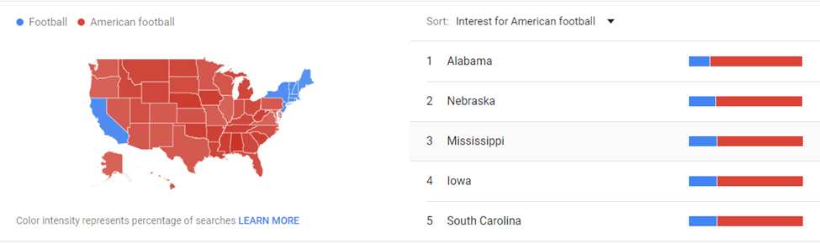
Example:
2- Comparison of Football and American Football in USA

Slide 6
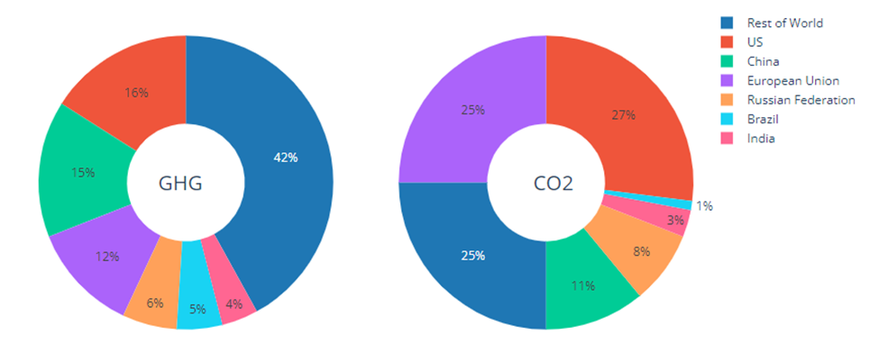
Example:
3- Global Emissions 1990 – 2011

Slide 7
What is Plotly:
It’s Python library is an interactive, open-source plotting library that supports over 40 unique chart types covering a wide range of statistical, financial, geographic, scientific, and 3-dimensional use-cases.
https://plotly.com/python/plotly-fundamentals/
https://plotly.com/python/basic-charts/

Slide 8
Visualization Will Be Discussed :
Bar Charts
Box Plots
Violin Plots

Slide 9
What is Bar Chart (Bar graphs):
A bar graph is a graph that shows complete data with rectangular bars and the heights of bars are proportional to the values that they represent.
Bar Chart Types:
Vertical Bar Graph
Horizontal Bar Graph
Grouped Bar Graph
Stacked Bar Graph

Slide 10
Why To Use Bar Chart:
The bars give a visual display for comparing quantities in different categories.
It is used to compare data sets. Data sets are independent of one another.
It helps in studying patterns over long periods of time.

Slide 11
JUPYTER TIME

Slide 12
Box Plot (whisker plot):
What is Box Plot and Why It’s Useful:
A box plot or whisker plot is a type of chart often used in exploratory data analysis.
Box plots visually show the distribution of numerical data and skewness through displaying the data quartiles (or percentiles) and averages.

Slide 13
Box plots show the five-number summary of a set of data:
Minimum Score: The lowest score
Lower Quartile: Twenty-five percent of scores fall below the lower quartile value
(also known as the first quartile).
Median: It marks the mid-point of the data and is shown by the line that divides the box
into two parts (sometimes known as the second quartile).
Upper Quartile: Seventy-five percent of the scores fall below the upper quartile value
(also known as the third quartile).
Maximum Score: The highest score

Slide 14
JUPYTER TIME

Slide 15
What is a violin plot?
A violin plot imagines the distributions of numerical data for one or more groups
using intensity curves. The width of each curve corresponds to the approximate
frequency of data points in each region.
Densities are often accompanied by a superimposed chart type,
such as a box chart, to provide additional information.

Slide 16
When you should use a violin plot ?
Violin plots are used to observe the distribution of numeric data,
and are especially useful when you want to make a comparison of distributions
between multiple groups.
The peaks, valleys, and tails of each group’s density curve can be compared
to see where groups are similar or different.

Slide 17
JUPYTER TIME

Slide 18
Questions Time

Slide 19

Thank you.
Very much!

